Slide 1



Best Practices in University Counseling Services
Osama Abdullah
Fall 2026
Creative Minds Transform the World

Slide 2
Seminar Objectives
Understand essential components of effective counseling programs.
Learn practices for providing mental health support.
Develop crisis intervention skills.
Explore innovative counseling techniques.
Foster a supportive campus environment.
Creative Minds Transform the World

Slide 3
Importance of Counseling in Student Affairs
The role of counseling in student success. Our primary mission is to provide assistance, helping students to succeed academically and in life. AND we are committed to providing a safe place for students, where they can be heard and empowered to realize their own identity and potential as future leaders.
“According to the American College Health Association, 63% of college students felt overwhelming anxiety in the past year.“ American College Health Association. (2023).
Creative Minds Transform the World
Notes:
"Approximately 50% of college students reported feeling overwhelming anxiety in the past year."
Reference: American College Health Association. (2023). National College Health Assessment II: Undergraduate Student Reference Group Executive Summary Spring 2023. Retrieved from [ACHA website].

Slide 4


Key Elements of Successful Counseling Services
"Only 25% of students with mental health issues seek help."
Accessibility and availability of services.
Trained and diverse counseling staff.
Comprehensive mental health and well-being resources.
Collaboration with other campus departments.
Creative Minds Transform the World
Notes:
"Only 25% of students with mental health issues seek help."
Reference: Eisenberg, D., Hunt, J., & Speer, N. (2021). Help seeking for mental health on college campuses: A systematic review. Psychological Services, 18(3), 215-229. doi:10.1037/ser0000423.

Slide 5
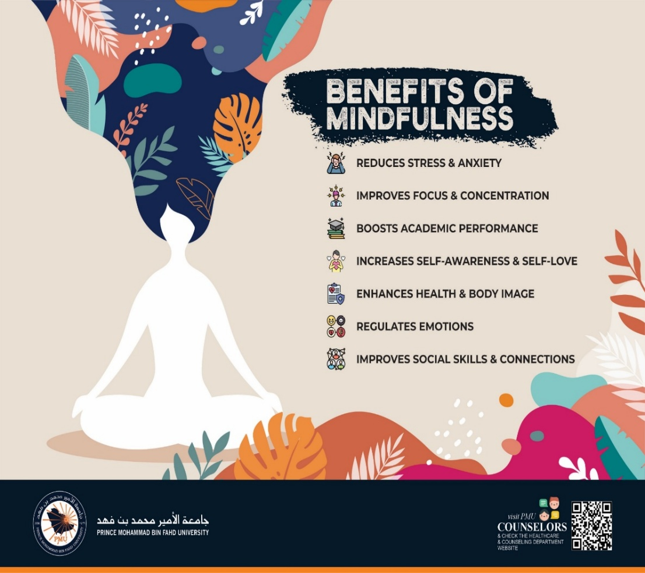
Outreach Strategies
Orientation sessions for new students
Orientation sessions for faculty members
Individual counseling sessions
Group counseling sessions
Student club (Creative Minds & Vision)
Engaging publications (Infographics)
Short films
Referral requests from teachers and students
Lectures for faculty coverage
Awareness tours
Official email (Be-Informed)
Website
Creative Minds Transform the World

Slide 6
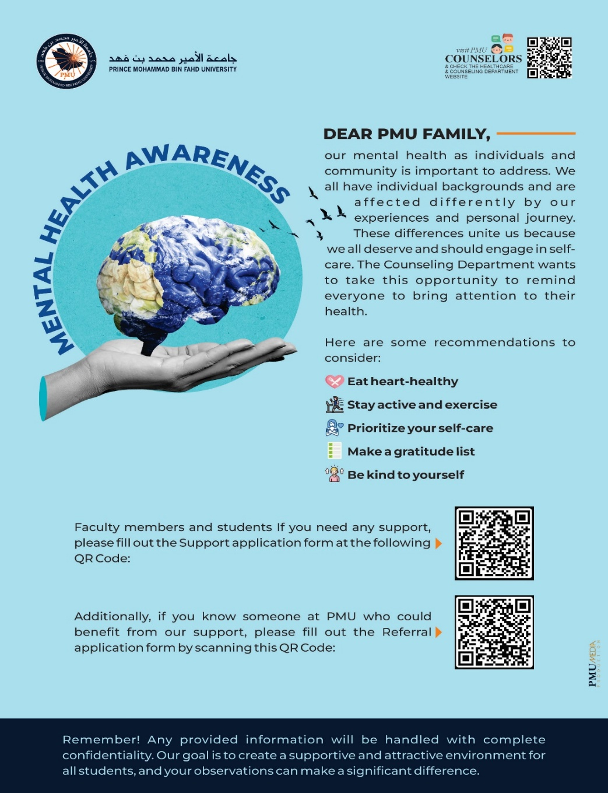
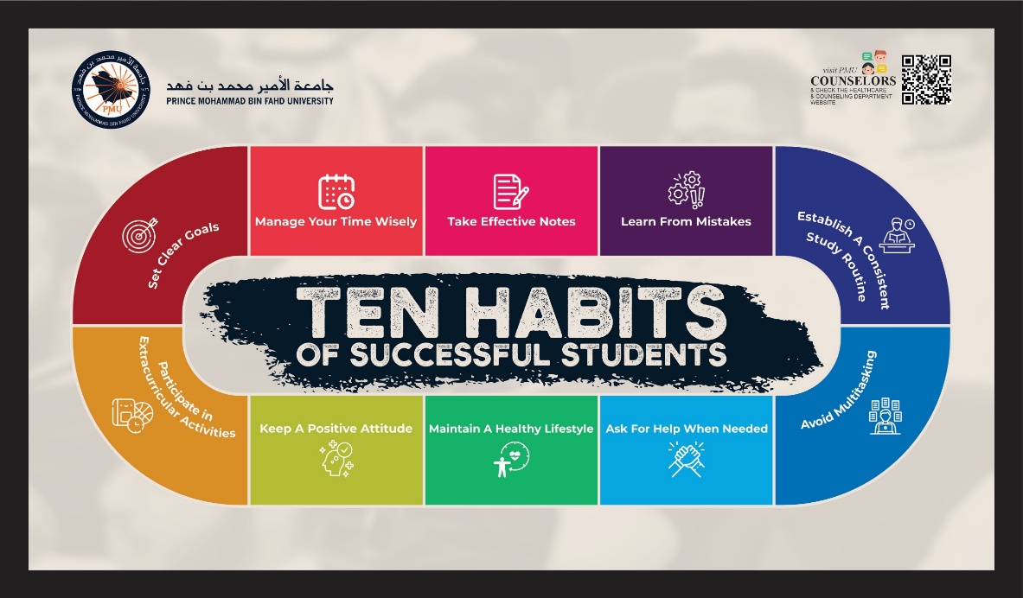
Outreach Strategies
Creative Minds Transform the World

Slide 7
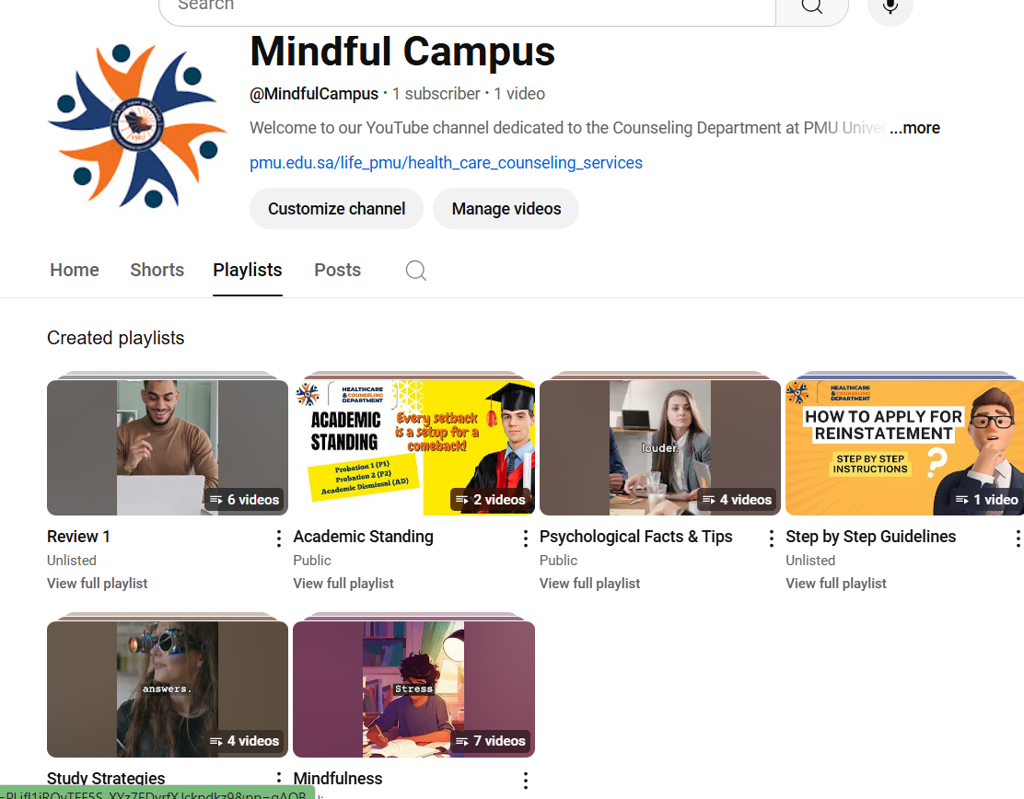
التقنيات والاستراتيجيات للتواصل!
Creative Minds Transform the World

Slide 8
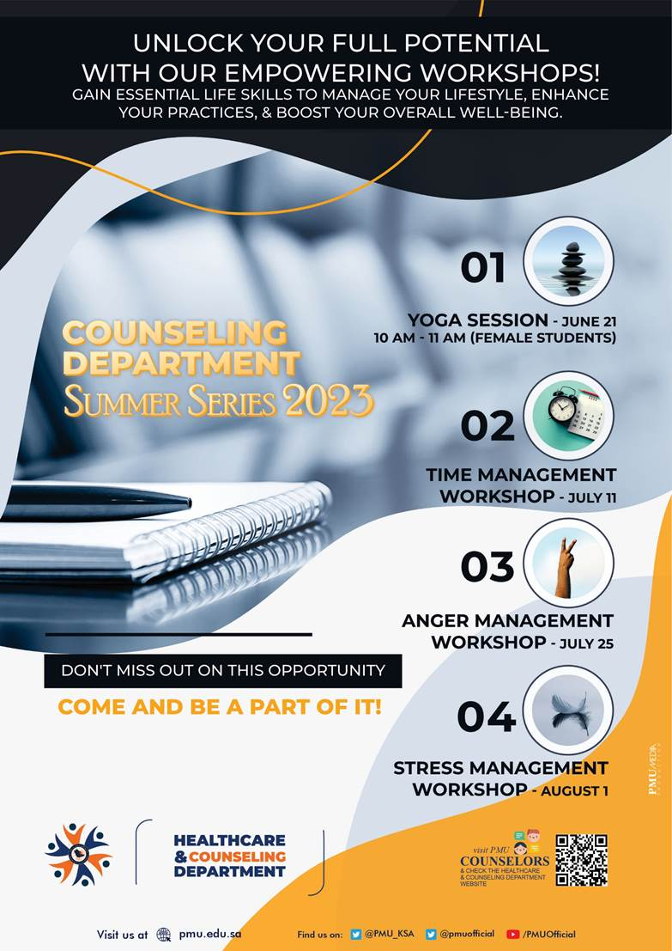
Workshops
Stress Management
Study Skills
Time Management
Mindfulness and Meditation
Test Anxiety Management
Goal Setting and Motivation
Nutrition and Dietary Quality
Direct Support During Final Exams
Health Week
Mental Health Day
Creative Minds Transform the World

Slide 9
Special Cases and Special Needs
Mental Challenges
Physical Challenges
Auditory and Visual Challenges
Humanitarian Initiatives
Creative Minds Transform the World

Slide 10
Academically At-Risk Students
P1, P2, AD, AR
Academic Planning, Registration, and Follow-Up
Creative Minds Transform the World

Slide 11
Crisis Intervention and Management
"Research indicates that 1 in 5 college students experience a mental health crisis during their academic career.“Kitzrow, M. A. (2022)
"Effective crisis intervention can reduce the risk of suicide by up to 90% when appropriate support is provided.“ Jobes, D. A., & Mann, J. J. (2021).
Creative Minds Transform the World
Notes:
Crisis Intervention and Management
Statistic: "Research indicates that 1 in 5 college students experience a mental health crisis during their academic career.“
Reference: Kitzrow, M. A. (2022). The mental health needs of today’s college students: Challenges and recommendations. NASPA Journal, 59(1), 167-181. doi:10.2202/1949-6605.1310.
Statistic: "Effective crisis intervention can reduce the risk of suicide by up to 90% when appropriate support is provided."
Reference: Jobes, D. A., & Mann, J. J. (2021). The role of clinical assessment in the prevention of suicide. American Journal of Psychiatry, 178(10), 911-917. doi:10.1176/appi.ajp.2021.21010001

Slide 12
Case Studies of Successful Interventions
ADHA
Suicide
Creative Minds Transform the World
Notes:
Crisis Intervention and Management
Statistic: "Research indicates that 1 in 5 college students experience a mental health crisis during their academic career.“
Reference: Kitzrow, M. A. (2022). The mental health needs of today’s college students: Challenges and recommendations. NASPA Journal, 59(1), 167-181. doi:10.2202/1949-6605.1310.
Statistic: "Effective crisis intervention can reduce the risk of suicide by up to 90% when appropriate support is provided."
Reference: Jobes, D. A., & Mann, J. J. (2021). The role of clinical assessment in the prevention of suicide. American Journal of Psychiatry, 178(10), 911-917. doi:10.1176/appi.ajp.2021.21010001

Slide 13
Summary of Key Takeaways
Recap of essential components of effective counseling.
Importance of mental health support.
Innovative practices to implement.
Creative Minds Transform the World
Notes:
Crisis Intervention and Management
Statistic: "Research indicates that 1 in 5 college students experience a mental health crisis during their academic career.“
Reference: Kitzrow, M. A. (2022). The mental health needs of today’s college students: Challenges and recommendations. NASPA Journal, 59(1), 167-181. doi:10.2202/1949-6605.1310.
Statistic: "Effective crisis intervention can reduce the risk of suicide by up to 90% when appropriate support is provided."
Reference: Jobes, D. A., & Mann, J. J. (2021). The role of clinical assessment in the prevention of suicide. American Journal of Psychiatry, 178(10), 911-917. doi:10.1176/appi.ajp.2021.21010001

Slide 14

Thanks you all
Creative Minds Transform the World

